Slide 1
Approximating Outside the Processor
Phillip Stanley-Marbell, Martin Rinard
Presentation by Cody LaFlamme
Notes:
I’m covering “approximating outside the processor”. It’s a relatively short paper, but it’s a review paper that outlines a lot of different ways approximate computing can be used outside of processing units. Because it’s a review paper, I’m going to skip a lot of math, and just introduce several methods with some example results from each. They’re all really cool, and I’m really happy to be able to talk about them all.

Slide 2
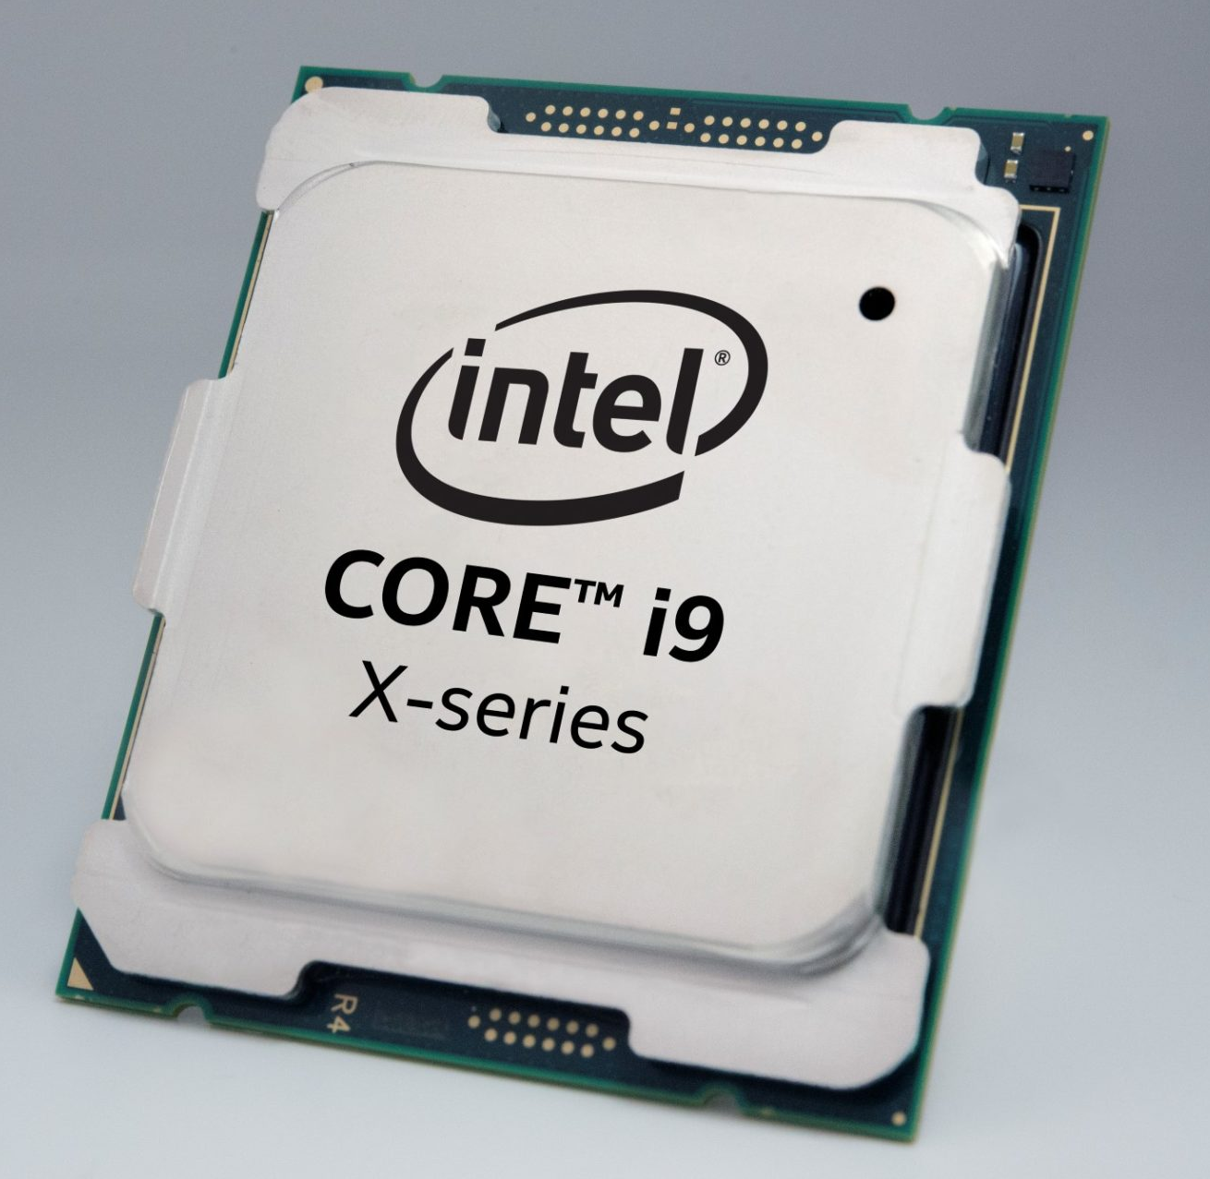
Introduction
Many approximate computing methods try to optimize calculations, especially for scientific computing.
These efforts focus on operations performed by processing units (CPU, GPU, NPU, FPGA’s).
Notes:
Most approximate computing methods we’ve studied try to optimize number crunching, calculations, and outputs. They focus on helping a processing unit, whether it’s a CPU, GPU, NPU or FGPA. But, there are a lot...

Slide 3
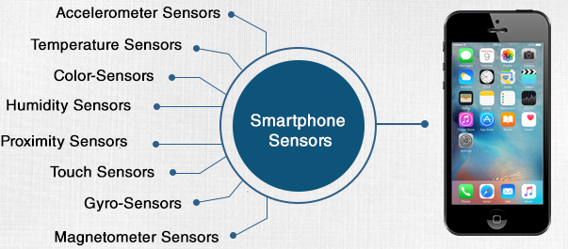
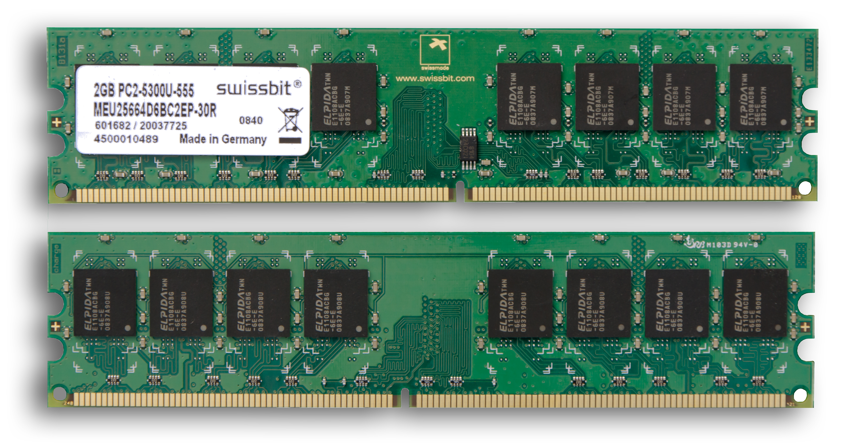
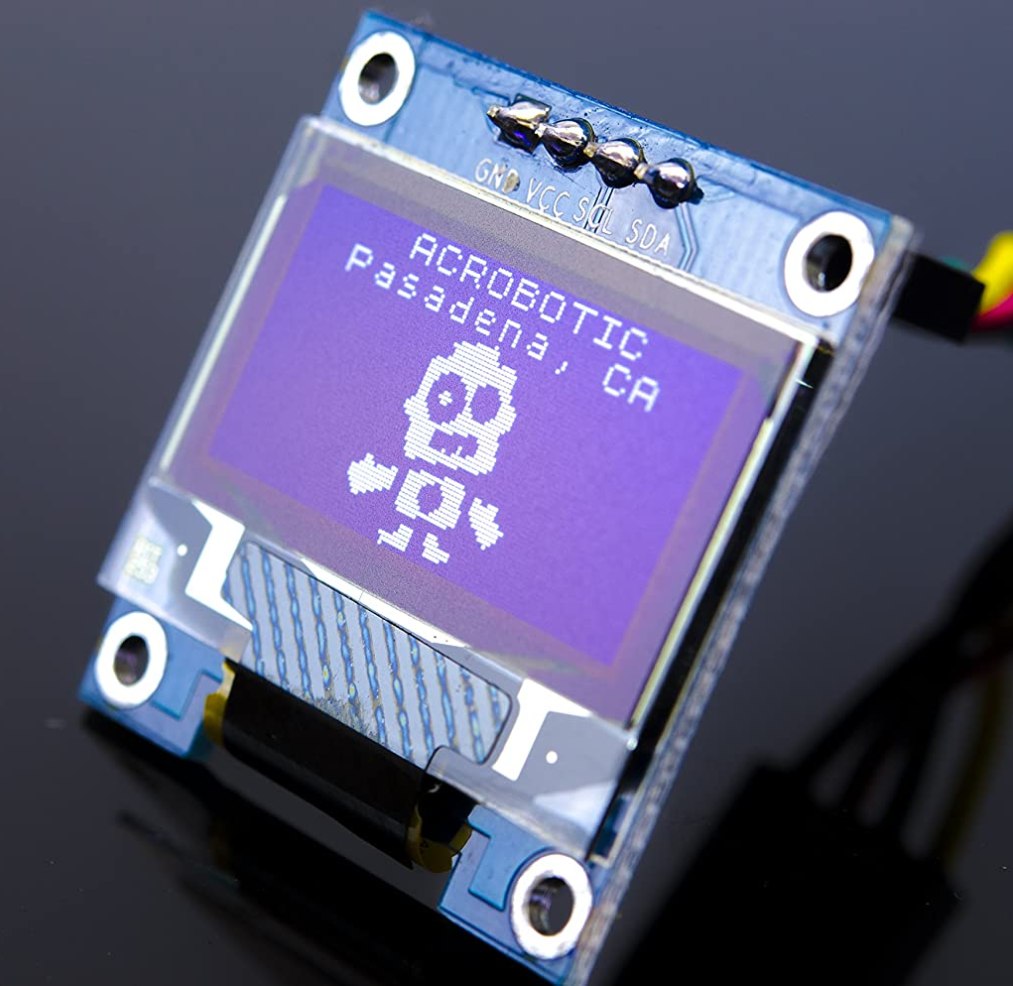
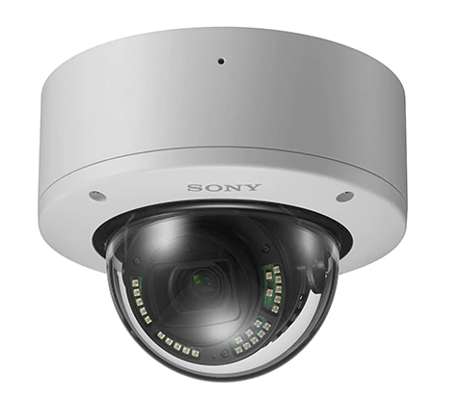
Introduction
Many approximate computing methods try to optimize calculations, especially for scientific computing.
These efforts focus on operations performed by processing units (CPU, GPU, NPU, FPGA’s).
However, there is a lot more than just a processing unit in any given system!
New methods are necessary to lower power use in these other components.
Notes:
... more components in a system than just the processing unit. There’s memory, and there can be displays, wireless modules, cameras, and a bunch of other sensors like gyroscopes and temperature sensors. Most of these are in smartphones, and a lot of these are in embedded devices for things like weather stations and other data acquisition setups. A lot of these components are in Internet of Things devices, portable game systems, and other common devices seen every day. A lot of these devices care about battery life and power usage, which is a thing approximate computing can help. But, to effectively use approximate computing, we want to apply it to the components that draw the most power.

Slide 4
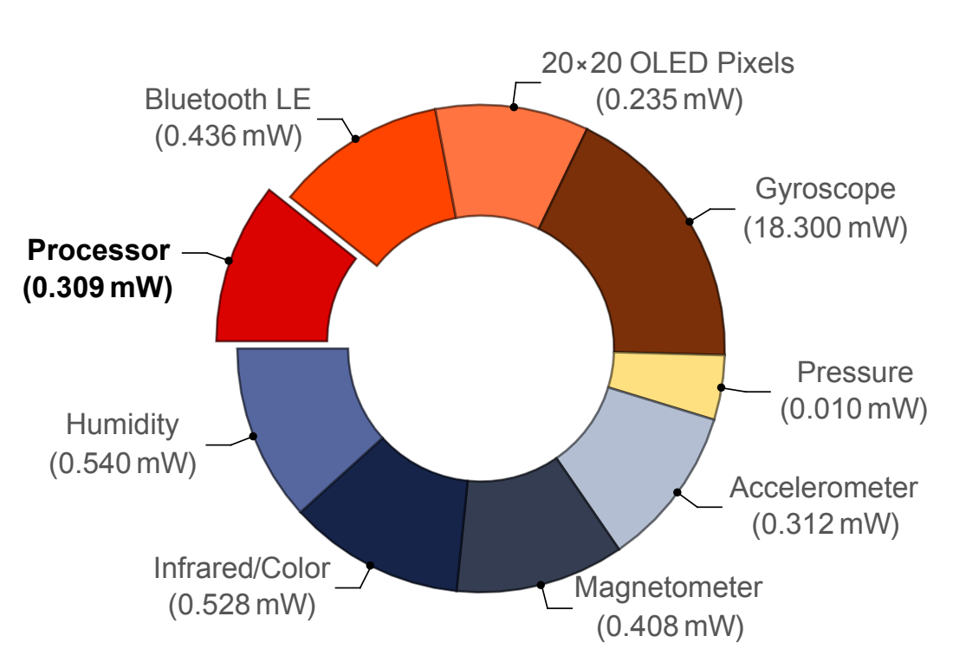
An Example
This paper focuses on optimizations that mostly help embedded systems, mobile and wearable devices, and other sensor-heavy systems.
Authors claim that sensors, data transmission, and memory dominate power use in these systems, so these are the targets for optimization.
Figure 1 from the paper. Displays power use in an example system created by the authors. Wedges are sized on a logarithmic scale.
System uses the “lowest-power variant of the ARM architecture currently available”, and many “state of the art” sensors, with the bluetooth module in pairing mode.
Notes:
As it turns out, in most of these portable or embedded systems, the processing unit does not use the most power. Sensors, internal data transmission, and displays all use significant amounts of power. This figure here is from the paper, and illustrates power used by several components in a system with many sensors. As you can see, the processor uses only a small minority of the power used by the full system. So, it makes sense to target things other than the processor for optimization. But, how do we do that, if most studies we’ve seen target the processing unit? Well...

Slide 5
Approximation Overview
Objective:
Lower power use in sensor-heavy systems.
Approximation Types:
Sensor power vs accuracy tradeoffs, efficient data encoding, acceptably fuzzy output
Parties involved:
Sensor drivers, sensor circuits, programs that use data, consumers of output
Strategies:
Customize sensor drivers to accept error, limit sensor power
Represent data in a way that is easier to transmit
Optimize outputs to have error that is unnoticeable by the consumer (humans or systems)
Notes:
This paper lists several methods. Overall, there are three main strategies proposed: one tries to control sensors in such a way that they use less power but produce imprecise output, the second encodes data from sensors so that it is more efficient to transmit serially, and the third tries to allow certain errors into output that is undetectable to the consumer.

Slide 6
Approximate Inputs: Assumptions of Noise
Sensors have intrinsic noise. Can we accept more uncertainty to save power?
Notes:
So, let’s get into the sensor side of things. Sensors have intrinsic noise. It’s always true. Anything that takes information from a sensor should be ready to deal with some amount uncertainty in the data. So, in some cases, we can exploit this. One example given is some of the author’s prior work.

Slide 7
Approximate Inputs: Assumptions of Noise
Sensors have intrinsic noise. Can we accept more uncertainty to save power?
Lax: “Lax provides a device driver abstraction that enables sensor data consumers to specify how much sensor error they can tolerate.” [18]
An example pedometer block diagram:
Figures from [18].
Notes:
They create a system that they call “LAX,” which includes software that sits between a device driver and a program. It controls the sensor and tries to minimize energy consumption while still delivering acceptable data according to bounds set by the programmer. The imprecise data is passed to the program, which is written to handle the imprecision.

Slide 8
Lax: The Software Portion
Lax is a configurable library. Error bounds and device information are provided by the programmer.
Figures from [18].
Notes:
The software required to use Lax is a configurable C library: The programmer includes Lax when writing code, and must provide Lax with information about the device’s error rate at various voltage levels. This is either included in device specifications, or the programmer can experimentally find the error at various supply voltages. The programmer also has to provide tolerable error bounds, and use a special, provided compiler to build lax. They can then use a traditional compiler to build the full program, and run it on the target system. Lax is supposed to take care of any run-time errors that occur when interfacing with the sensor (if they’re not the program’s fault).

Slide 9
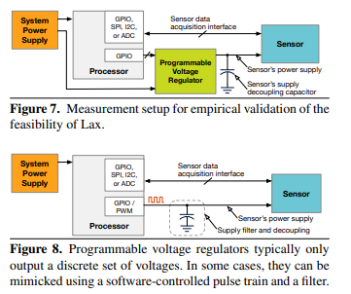
Lax: The Hardware Portion
Lax must be able to dynamically control the sensor’s voltage level.
A programmable voltage regulator can be used.
Figures from [18].
Notes:
Lax then interfaces with the sensor using the sensor’s normal driver software, and also controls the sensor’s supply voltage using a programmable voltage regulator or an equivalent analog circuit.

Slide 10
Lax: Some Remarks
The provided system allows the programmer to place several constraints on results, including:
Value-deviation (i.e. numerical error)
Latency (time to get a valid reading)
Error rate (the frequency at which sensor readings yield garbage results)
Loss (with an arbitrary loss function)
This method might use sensors at supply voltages outside the manufacturer-suggested range! Lax can theoretically adjust voltage dynamically to stay within provided constraints.
Notes:
Now, before I move on to some experimental results, I want to clarify a couple things. I’ve been using the words “error bounds” quite loosely. Lax actually allows the programmer to place several different kinds of constraints on the sensor output, and error is only one of them. A programmer can also place constraints on latency (which is the time it takes to get a valid measurement), error rate (which is the rate at which the sensor simply malfunctions and does not yield valid output), and even loss using an arbitrary loss function written by the programmer. Also, as someone in canvas pointed out, the authors are unapologetically using devices at supply voltages that they are NOT rated for. The authors simply comment that “devices still work outside the rated range”. The fact that a designer or programmer has to provide lax with error rates at various voltages from their device means that results should be roughly predictable, at least in the short term. I don’t know how using a device outside its rated range can affect a device long term, but the authors to my knowledge, do not say anything about it. Theoretically, though, lax could dynamically adjust supply voltage if a device suddenly starts behaving unexpectedly, so it might still be OK. This is one of the strangest parts of the work... it seems a little crazy. But whatever we think about it, they have some decent results.

Slide 11
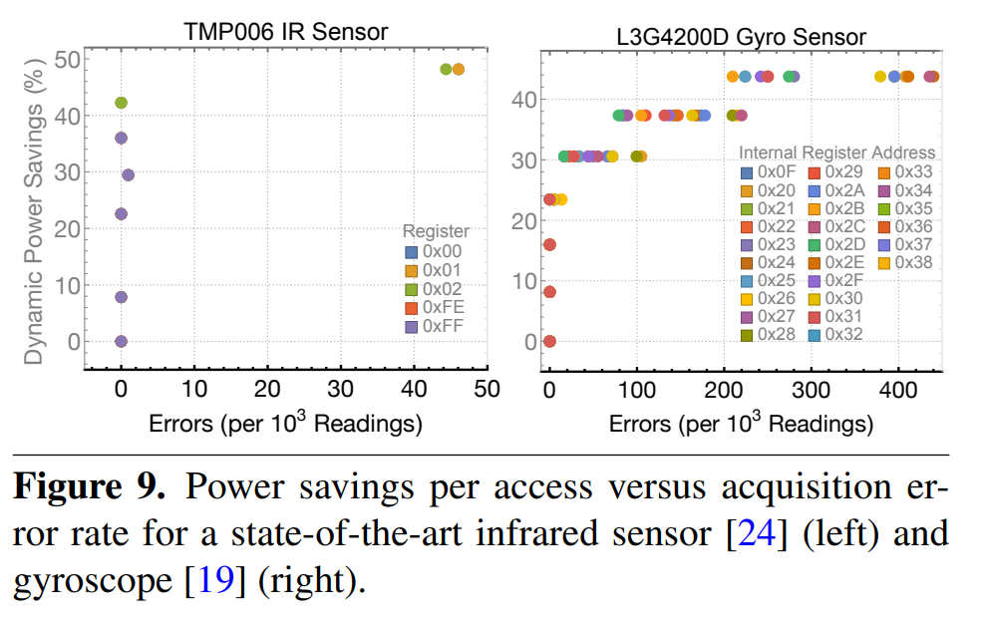
Example Lax Results
One can clearly see the tradeoff between voltage and error likelihood.
This works for some sensors better than others.
Figures from [18].
Notes:
Here we have error rate and power savings for two tested sensors. On the x-axis is the number of invalid results per 1000 readings, and on the y axis is the percent of power saved by lax. On the left, we have results from a temperature sensor, and here, there’s almost no drop in quality from the sensor. We just get almost 50% power savings for free, just trusting Lax to take care of the device for us. On the right, we have results from a gyroscope sensor. Here, the tradeoff is clearly visible. We have a nice curve that we can use to find a good compromise between power savings and error rate. Even though the tradeoff is more defined, we can still get almost 25% in power savings for free, which is pretty good, especially if we remember that the gyroscope in the example system we saw earlier took up the most power out of any one component, by a significant margin. The gyroscope is the reason they had to use a log scale, because it uses almost 30 times more power than anything else. So, this has been Lax. It’s a way to get approximate sensor readings in order to save power. Let’s move on to another method we can use to approximate sensor readings.

Slide 12
Approximate Inputs: Assumptions of Noise
Sensors have intrinsic noise. Can we accept more uncertainty to save power?
Notes:
Instead of manipulating the sensors themselves, or doing irresponsible with their voltage supplies, we can target a different thing that draws a lot of power.

Slide 13
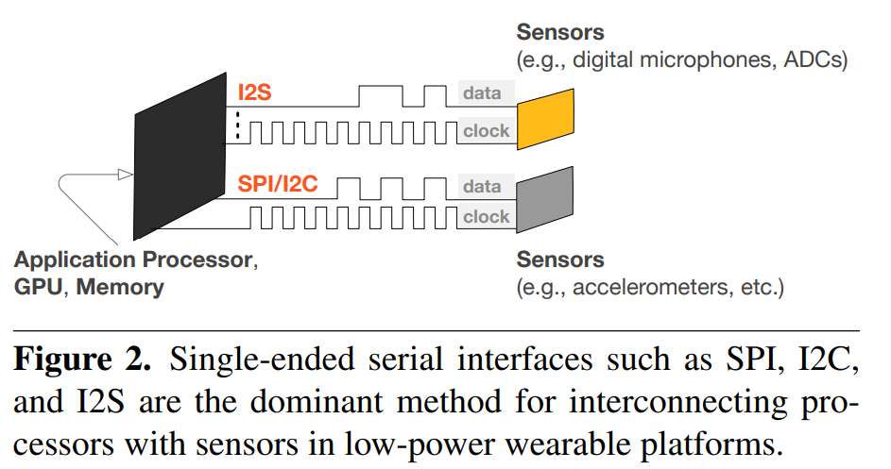
Approximate Inputs: Assumptions of Noise
Sensors have intrinsic noise. Can we accept more uncertainty to save power?
Sensor data is sent serially... This takes a lot of power!
“At data rates of just 10 Mb/s, and aggregated over several sensor interfaces, data transfer power becomes a significant fraction of system power.” [19]
Figures from [19].
Notes:
We can target serial data transfers that send data from sensors to the processor. According to one of the paper’s references, these transfers can, and I quote, “become a significant fraction of system power.” I wish there was a nice plot I could rip from the paper or any of its references, but no such figure existed. Anyways, for those that don’t know, when values are sent between devices serially, a single wire is made to flip back and forth between 0 and 1. This is a change in voltage, and so it costs energy. The paper lists a method to encode data that tries to reduce the number of times bits have to be flipped between 0 and 1.

Slide 14
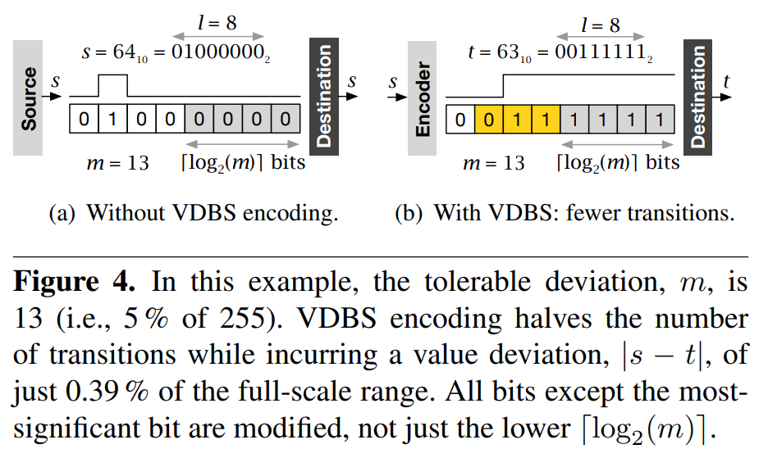
Approximate Inputs: Assumptions of Noise
Sensors have intrinsic noise. Can we accept more uncertainty to save power?
Value-Deviation-Bounded Serial encoders (VDBS encoders): Encoders that alter binary values to reduce bit flipping in serial communication.
Figures from [19].
Notes:
They create what they call “value-deviation-bounded serial encoders.” These encoders accept serial input and produce serial output values that minimize bit flipping while meeting specified “value deviation bounds,” essentially error bounds. For brevity’s sake, I’m not going to cover the details of the encoding algorithm, but I will explain the concept. A simple example is on the right: here we have 64 in binary. As you can see, transmitting this value will require the line to go from 0, to 1, and back to 0. If we change this value to 63, we only have to change the voltage once. This is half the bit flips, with literally minimal error. This might seem like a silly example, but it shows how the concept works. So, now that we know the concept,

Slide 15
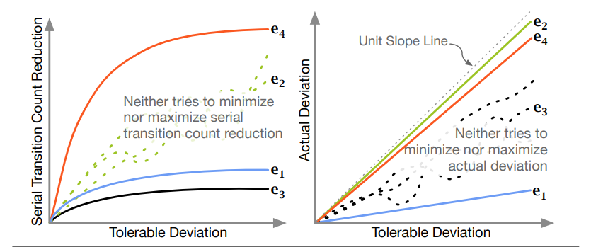
Tradeoffs in VDBS
One can choose perfect transmission (no encoding) or perfect bit-flipping reduction (always outputting 0 or 1). Neither of these are acceptable!
Many strategies exist, and each handles the tradeoff differently.
Figures from [19].
Notes:
...a tradeoff becomes apparent. Perfect transmission means there’s no power savings: you’re sending the exact value, and not approximating, while perfect power savings means we’re never sending any bits over: we’re just sitting at 0 or 1 all the time. The figure shows how several different strategies balance error tolerance (x axis) and the number of bits flipped (which they call “serial transition count”). One must choose a method that performs acceptably. But how do we do that? As it turns out the authors just chose a method that was computationally efficient.

Slide 16
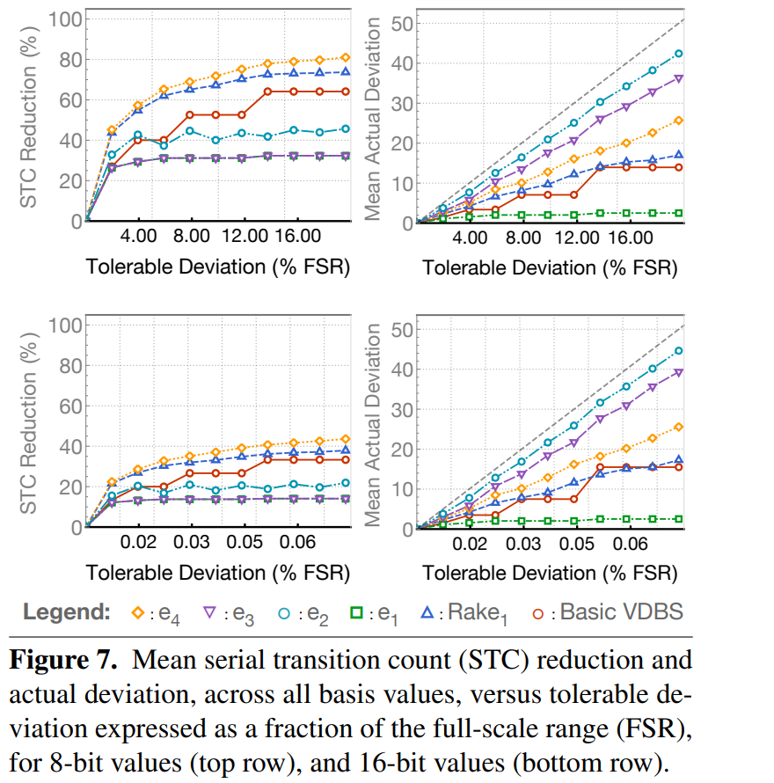
Rake: Practical VDBS
The authors create “Rake”: a O(n) algorithm that implements VDBS encoding.
Performance is much better for 16-bit values than 8-bit values (note the difference in x-axes).
Figures from [19].
Notes:
They find an algorithm that achieves good results with linear time complexity. They call it Rake, because it only requires two passes over the input bits. Given arbitrary error bounds for signals of arbitrary bit width, it guarantees that encoded data will stay within the required error bounds, while lowering bit flipping by a nearly optimal amount. The algorithm is deterministic: for any given input, it will always produce the same output. With this in mind, we can examine the performance of rake for integers of various bit widths. Shown on the right are average results for all 8-bit and 16-bit values, using 4 selected implementations from the previous slide (e1 - e4) and rake, which is the blue triangles. As we can see, rake doesn’t optimize for serial transition reduction as much as it could, but it achieves pleasant results. For 16-bit values, we get an average 40% transition reduction for less than 1% full-range error!

Slide 17
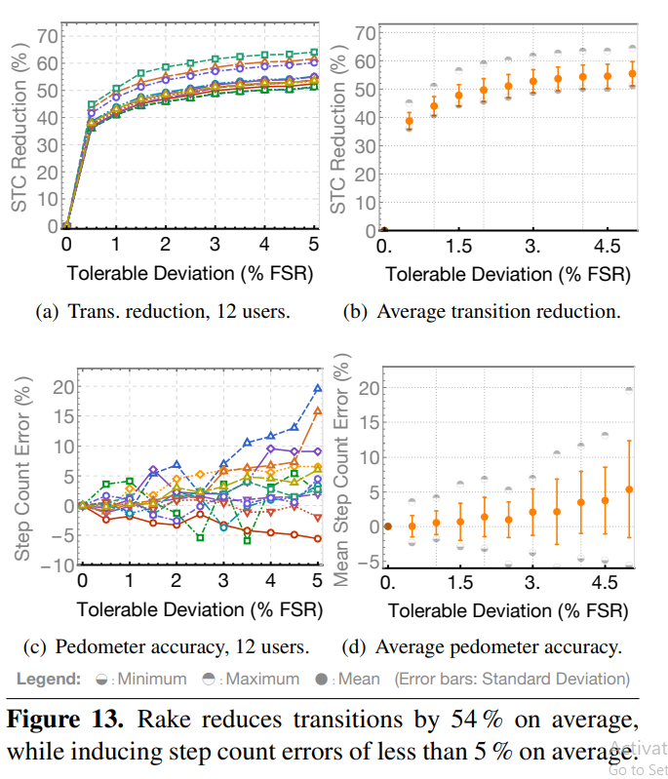
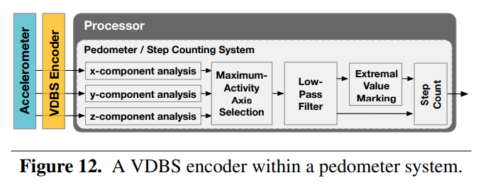
Rake: A Case Study
Accelerometer readings are encoded on their way to the processor inside a pedometer.
Results see a 54% decrease in bit transitions with 5% step count error.
Figures from [19].
Notes:
The authors also perform a case study, where they used rake in a real device: accelerometer readings are passed through rake and sent to a processor in a pedometer, or step counter. In this experiment, they saw a 54% decrease in bit flipping with only a 5% error in step count. It’s nice to see the effects that the error caused by approximation can have in a real device, as it shows that it could be acceptable in some use cases if power is important.

Slide 18
Approximate Outputs: Limits of Perception
Humans have imperfect vision: our brains take shortcuts. Do we really need perfect output?
Notes:
Now, paper moves on. It’s talked about ways to approximate values from sensors to lower power consumption, before values even reach the processor, but we can also try to approximate the full system’s output, and save power in things that come after the processor: the system’s display or speakers. The paper suggests producing intentionally imperfect visual or audio outputs, where the imperfections are unnoticeable (or at least acceptable) to humans. For this method, the paper lists a bunch of sources, but most of them aren’t really approximate computing: they focus on manually selecting full color palettes that save power when displayed on phone screens, so I’m skipping those. One source that might be an example of approximate computing...

Slide 19
Approximate Outputs: Limits of Perception
Humans have imperfect vision: our brains take shortcuts. Do we really need perfect output?
Maybe not! “Human-aware color space” can be used to quantify error in images, accounting for how human vision works.
Notes:
...uses a “human-aware color space” to evaluate approximated images produced on an OLED screen, and judge how close they are to the original from the perspective of a human viewer.
This group utilizes what they call “dynamic voltage scaling” to alter the colors on a OLED screen to reduce power use while minimizing any visible change.

Slide 20
OLED Basics
Organic Light Emitting Diodes (OLEDS) are lights deployed in grids to form digital displays.
Notes:
OLEDs, organic light emitting diodes, are frequently used to represent pixels in modern screens.

Slide 21
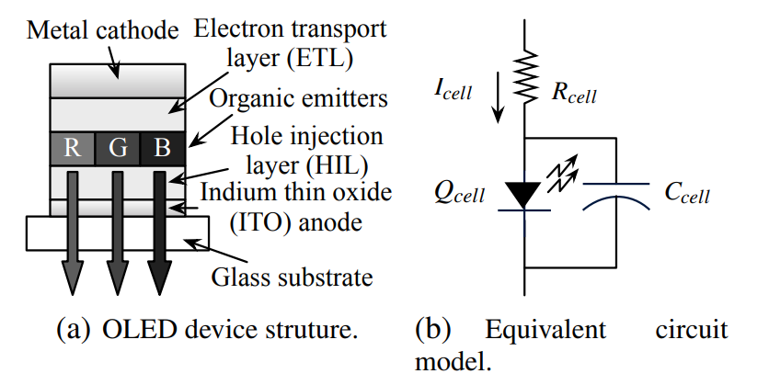
OLED Basics
Organic Light Emitting Diodes (OLEDS) are lights deployed in grids to form digital displays.
Each pixel has three lights: red, green, and blue. Brightness of each light is determined by three digital values from 0 to 255.
Figures from [12].
Notes:
Each pixel is represented by three lights: red, blue, and green. Each color’s brightness is set by a digital value inside a set range. In modern OLED screens...

Slide 22
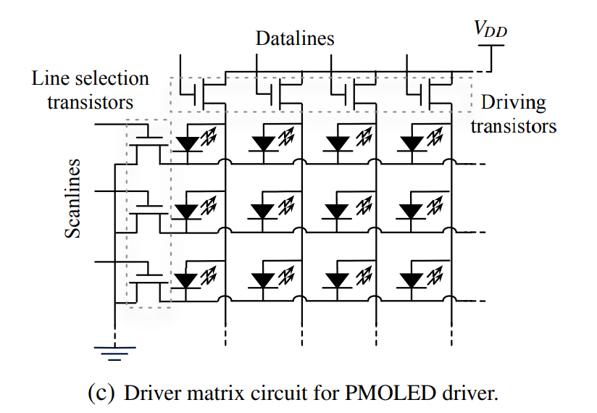
OLED Basics
Organic Light Emitting Diodes (OLEDS) are lights deployed in grids to form digital displays.
Each pixel has three lights: red, green, and blue. Brightness of each light is determined by three digital values from 0 to 255.
Figures from [12].
Notes:
...all LEDs are lined up in a grid, and are given the same voltage supply, and the voltage supply is held static at all times. This is where power saving becomes possible: every LED is told to reach a target brightness between 0 and 255 by signals along a data line. If none of the LEDs are trying to reach full brightness at 255, then none of the LEDs will be effectively using the full voltage supply. Any difference between the maximum desired voltage on an LED and the provided supply voltage is essentially wasted energy.

Slide 23
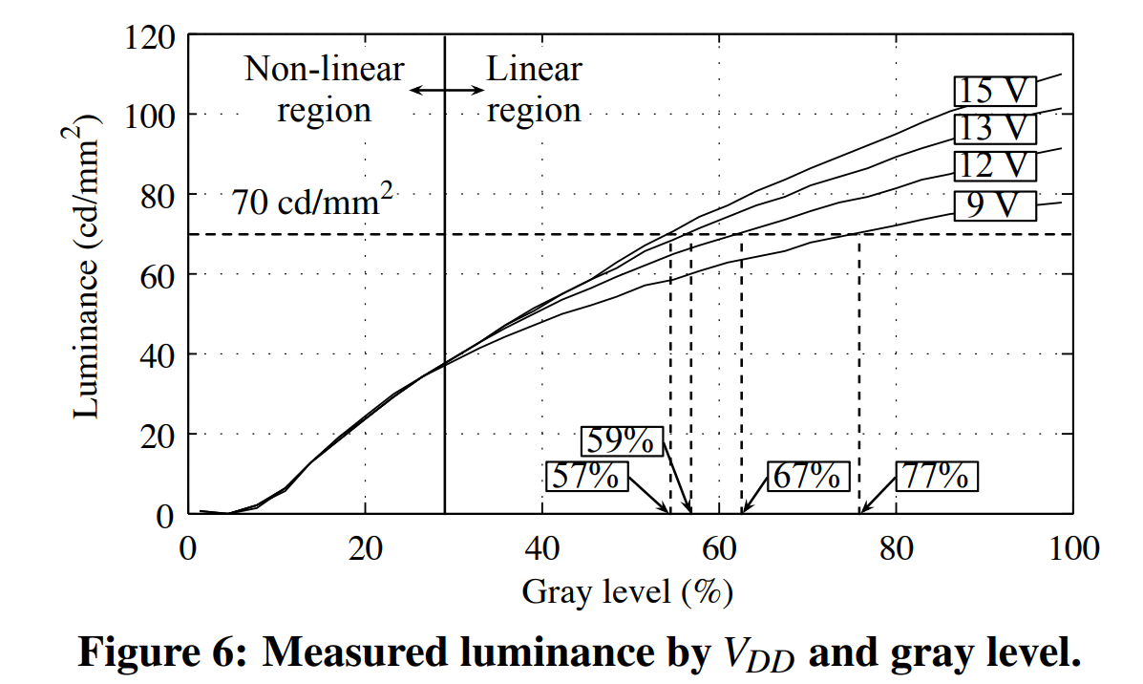
Dynamic Voltage Scaling (DVS)
The supply voltage does not need to be higher than the maximum desired LED voltage!
We can lower the supply voltage to just barely meet voltage requirements, but the digital image must be brightened to compensate, so the same luminance is (usually) reached.
Figures from [12].
Notes:
The authors thus decide to dynamically adjust the supply voltage of the OLED screen to just barely allow all LEDs to reach the desired voltage. They call this “dynamic voltage scaling.” However, doing this causes the brightness of all pixels in the grid to decrease, due to decreased current. To fix this, the authors artificially manipulate the digital image signal going into the screen, raising the desired brightness value for all pixels to compensate for the lower supply voltage. Theoretically, all pixels end up at the intended color and brightness, and less power is wasted.

Slide 24
DVS: Approximation for Better Efficiency
We can opt to be worse than perfect for better power savings.
At too-low supply voltages, we may not be able to digitally brighten all pixels highly enough, causing distortion in bright pixels... but this might be worth the power savings.
Figures from [12].
Notes:
However, we can accept some amount of imperfection in order to stay at lower supply voltages. If there is a small number of bright pixels in an image, we can remain at a lower supply voltage than we would normally need, and digitally brighten the brightest pixels as much as possible. They won’t end up the perfect brightness, and the resulting image would be an approximation. However, this distortion may not be impactful.

Slide 25
DVS: Human-aware color space
When digitally brightening images, math is performed to make the digitally-brightened image as close as possible to the original image in human-aware color space.
“The [human-aware] color space considers two colors to be perceptually identical when the Euclidean difference between the two color is less than a certain threshold. The threshold is generally determined by the human vision characteristics...”
Thus, approximations exploit human biology to save extra power.
Figures from [12].
Notes:
[just read the slide]. There’s a lot of math that I don’t have time to cover, but this explains the concept.

Slide 26
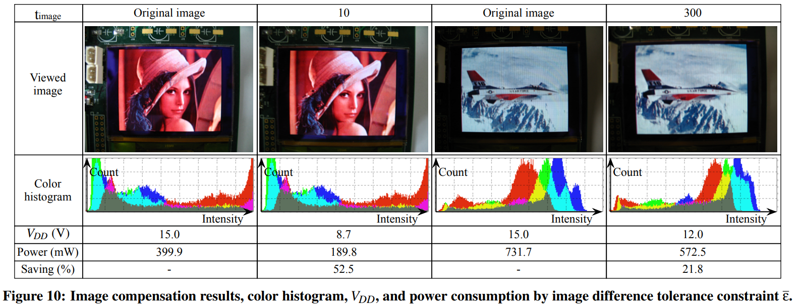
Dynamic Voltage Scaling: Results
Figures from [12].
Notes:
Here we have some sample images. The image quality in the paper is slightly troublesome, but it should be visible that there is less distortion between the original image and the approximated image in the darker images (on the left) than in the brighter pair of images (on the right). The darker images naturally allowed more power to be saved, saving 52% of power with very little noticeable distortion. The brighter approximated image seems acceptable in quality, and still saves 21.8% of the normal power draw.

Slide 27
Concluding Remarks
The authors of this paper advise us to examine the theoretical upper bounds of benefits we may get from approximation.
They believe this can bring about higher understanding of problems, and allow for new solutions to be found.
The authors of this work were inspired to create the VDBS encoding method after trying to quantify the maximum potential of alternate binary representations for approximate communication.
Notes:
The paper has a final section that’s not really specific to approximate computing, but [just read the slide].

Slide 28
Multiple Choice Questions
What commonly draws significant amounts of power in common embedded systems?
Sensors
The processing unit
Serial data transmission
Both (a) and (c) [correct answer]
When would it be best to deliberately change the value read from a sensor to a less correct value before sending it to the processor serially?
To average out noise from the sensor
To reduce the number of bits that have to be flipped when transmitting the data [correct answer]
To throw off malicious agents who might steal the sensor’s data
To produce a more interesting-looking scatter plot
Why might it be useful to lower the resolution or accuracy of an otherwise perfectly fine sensor?
To reduce power consumption [correct answer]
To make other sensors less jealous
To make it easier to process the data
To lessen the effect of inaccuracies caused by floating point math

